Slide 1
Analyzing H1b visa data using Hadoop Ecosystem
Presented by:
Name: Anitta Joseph
Student ID: S171107500098
Center: Pune Deccan

Slide 2
Objective
To identify the growth cycle is increasing or not, which industry has granted more visas etc. By performing analysis on the H1B visa applicants between the years 2011-2015.

Slide 3
Analyzing Factors
We will be performing analysis on the H1B visa applicants between the years 2011-2015. After analysing the data, we can derive the following facts.
1 a) Is the number of petitions with Data Engineer job title increasing over
time?
b) Find top 5 job titles who are having highest growth in applications.
2 a) Which part of the US has the most Data Engineer jobs for each year?
b) find top 5 locations in the US who have got certified visa for each year.
3)Which industry has the most number of Data Scientist positions?
4)Which top 5 employers file the most petitions each year?

Slide 4
Analyzing Factors
5) Find the most popular top 10 job positions for H1B visa applications for each year?
6) Find the percentage and the count of each case status on total applications for each year. Create a graph depicting the pattern of All the cases over the period of time.
7) Create a bar graph to depict the number of applications for each year
8) Find the average Prevailing Wage for each Job for each Year (take part time and full time separate)
9) Which are top ten employers who have the highest success rate more than 70% in petitions filed more than 1000?
10) Which are the top 10 job positions which have the highest success rate more than 70% in petitions filed more than 1000?
11) Export result for question no 10 to MySql database.

Slide 5
Technology used
MapReduce : a parallel processing software framework. It is comprised of two steps. Map step is a master node that takes input and partitions them into smaller sub-problems and then distributes them to worker nodes. After the map step has taken place, the master node takes the answer to all of the sub-problems and combines them to produce output.
Hive : a data warehousing and SQL like query language that presents the data in the form of tables. Hive programming is similar to data Warehousing.
Pig : a platform for manipulating data stored in HDFS and that includes a compiler for map reduce programs and high level language called Pig Latin.it provides a way to perform data extractions, transformation and loading and basic analysis without having to write Map Reduce programs.
Sqoop : a connection and transfer mechanism that moves the data between hadoop and relational databases

Slide 6
Big Data
Big Data is a collection of large datasets that cannot be processed using traditional computing techniques.
Which is made up of commodity hardware.
Which contains both structured(Relational), semi structured(XML,JSON) and unstructured data(Word, PDF, Text and media logs ).
When “Big Data” emerged as a problem, Apache Hadoop evolved as a solution to it.

Slide 7
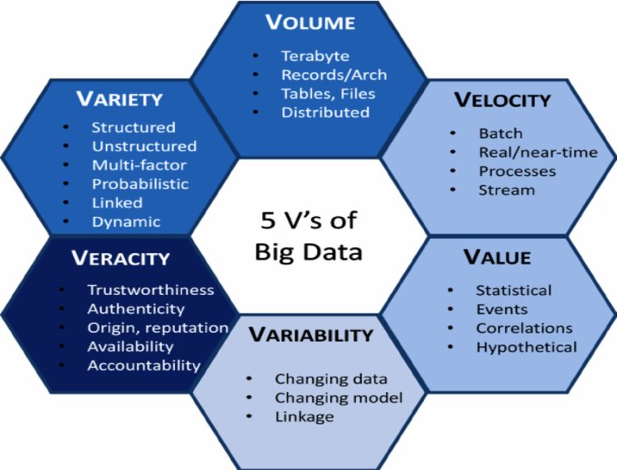
5 V’s of Big Data

Slide 8
Advantages of Big Data
Ability to store and process huge amounts of any kind of data, quickly. With data volumes and varieties constantly increasing, especially from social media and the Internet of Things (IoT), that's a key consideration.
Computing power. Hadoop's distributed computing model processes big data fast. The more computing nodes you use, the more processing power you have.
Fault tolerance. Data and application processing are protected against hardware failure. If a node goes down, jobs are automatically redirected to other nodes to make sure the distributed computing does not fail. Multiple copies of all data are stored automatically.
Flexibility. Unlike traditional relational databases, you don’t have to pre-process data before storing it. You can store as much data as you want and decide how to use it later. That includes unstructured data like text, images and videos.
Low cost. The open-source framework is free and uses commodity hardware to store large quantities of data.
Scalability. You can easily grow your system to handle more data simply by adding nodes. Little administration is required.

Slide 9
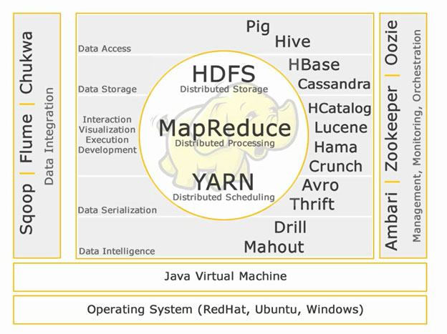
Hadoop Ecosystem

Slide 10
HDFS
The Hadoop Distributed File System (HDFS) is a distributed file system designed to run on commodity hardware.
HDFS is highly fault-tolerant and is designed to be deployed on low-cost hardware.
HDFS was originally built as infrastructure for the Apache Nutch web search engine project.
HDFS is has the concept of Write once and Read many times.

Slide 11
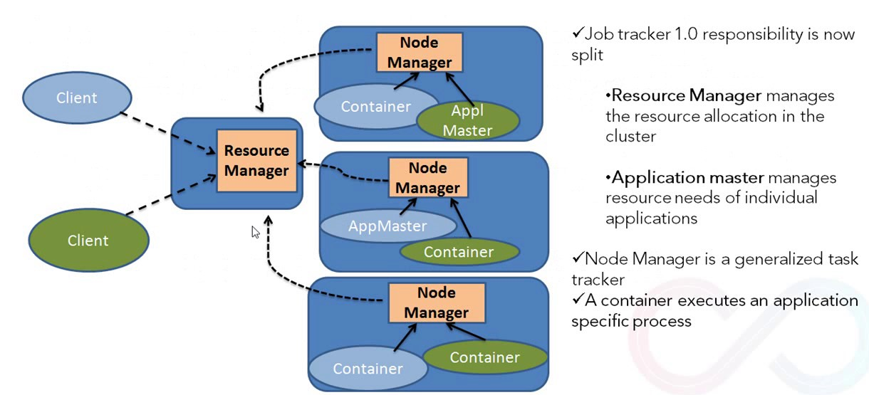
YARN
The fundamental idea of YARN is to split up the functionalities of resource management and job scheduling/monitoring into separate daemons. The idea is to have a global ResourceManager (RM) and per-application ApplicationMaster (AM). An application is either a single job or a DAG of jobs.

Slide 12
Analysing H1B Visa Using Hadoop Ecosystem
Analysis 1:
Is the number of petitions with Data Engineer job title increasing over time?
Technology used : Map Reduce
Sample output:

Slide 13
Analysing H1B Visa Using Hadoop Ecosystem
Analysis 1
b) Find top 5 job titles who are having highest growth in
applications.
Technology used: Map Reduce
Sample output:
BUSINESS ANALYST 2, 4930.00
SENIOR SYSTEMS ANALYST JC60, 4255.40
PROGRAMMER/ DEVELOPER, 4160.00
BUSINESS SYSTEMS ANALYST 2, 3966.80
SOFTWARE DEVELOPER 2, 3480.80

Slide 14
Analysing H1B Visa Using Hadoop Ecosystem
Analysis 2:
a) Which part of the US has the most Data Engineer jobs for
each year?
Technology used: MapReduce
Sample Output:
SEATTLE, WASHINGTON 2011 20
SAN FRANCISCO, CALIFORNIA 2011 4
SEATTLE, WASHINGTON 2012 30
SAN FRANCISCO, CALIFORNIA 2012 10
SEATTLE, WASHINGTON 2013 46
SAN FRANCISCO, CALIFORNIA 2013 17
SEATTLE, WASHINGTON 2014 45
SAN FRANCISCO, CALIFORNIA 2014 34
SEATTLE, WASHINGTON 2015 61
NEW YORK, NEW YORK 2015 41
SEATTLE, WASHINGTON 2016 128
SAN FRANCISCO, CALIFORNIA 2016 90

Slide 15
Analysing H1B Visa Using Hadoop Ecosystem
Analysis 2:
b) find top 5 locations in the US who have got certified visa for
each year.
Technology used: MapReduce
Sample Output:
SEATTLE, WASHINGTON 2011 20
SAN FRANCISCO, CALIFORNIA 2011 4
SEATTLE, WASHINGTON 2012 30
SAN FRANCISCO, CALIFORNIA 2012 10
SEATTLE, WASHINGTON 2013 46
SAN FRANCISCO, CALIFORNIA 2013 17
SEATTLE, WASHINGTON 2014 45
SAN FRANCISCO, CALIFORNIA 2014 34
SEATTLE, WASHINGTON 2015 61
NEW YORK, NEW YORK 2015 41
SEATTLE, WASHINGTON 2016 128
SAN FRANCISCO, CALIFORNIA 2016 90

Slide 16
Analysing H1B Visa Using Hadoop Ecosystem
Analysis 2:
b) find top 5 locations in the US who have got certified visa for each year.
Technology used : MapReduce
Sample output:
NEW YORK, NEW YORK 2011 23172
HOUSTON, TEXAS 2011 8184
NEW YORK, NEW YORK 2012 23737
HOUSTON, TEXAS 2012 9963
NEW YORK, NEW YORK 2013 23537
HOUSTON, TEXAS 2013 11136
NEW YORK, NEW YORK 2014 27634
HOUSTON, TEXAS 2014 13360
NEW YORK, NEW YORK 2015 31266
HOUSTON, TEXAS 2015 15242
NEW YORK, NEW YORK 2016 34639
SAN FRANCISCO, CALIFORNIA 2016 13836

Slide 17
Analysing H1B Visa Using Hadoop Ecosystem
Analysis 3:
Which industry has the most number of Data Scientist positions?
Technology used: Hive
Sample output:
STATISTICIANS 649
COMPUTER AND INFORMATION RESEARCH SCIENTISTS 500
OPERATIONS RESEARCH ANALYSTS 426
Computer and Information Research Scientists 208
COMPUTER OCCUPATIONS, ALL OTHER 179

Slide 18
Analysing H1B Visa Using Hadoop Ecosystem
Analysis 4:
Which top 5 employers file the most petitions each year?
Technology used: hive
Sample output:
2011 TATA CONSULTANCY SERVICES LIMITED 5416 1
2011 MICROSOFT CORPORATION 4253 2
2012 INFOSYS LIMITED 15818 1
2012 WIPRO LIMITED 7182 2
2013 INFOSYS LIMITED 32223 1
2013 TATA CONSULTANCY SERVICES LIMITED 8790 2
2014 INFOSYS LIMITED 23759 1
2014 TATA CONSULTANCY SERVICES LIMITED 14098 2
2015 INFOSYS LIMITED 33245 1
2015 TATA CONSULTANCY SERVICES LIMITED 16553 2
2016 INFOSYS LIMITED 25352 1
2016 CAPGEMINI AMERICA INC 16725 2

Slide 19
Analysing H1B Visa Using Hadoop Ecosystem
Analysis 5:
Find the most popular top 10 job positions for H1B visa applications for each year?
Technology used: hive
Sample output:
2011 PROGRAMMER ANALYST 31799 1
2011 SOFTWARE ENGINEER 12763 2
2012 PROGRAMMER ANALYST 33066 1
2012 SOFTWARE ENGINEER 14437 2
2013 PROGRAMMER ANALYST 33880 1
2013 SOFTWARE ENGINEER 15680 2
2014 PROGRAMMER ANALYST 43114 1
2014 SOFTWARE ENGINEER 20500 2
2015 PROGRAMMER ANALYST 53436 1
2015 SOFTWARE ENGINEER 27259 2
2016 PROGRAMMER ANALYST 53743 1
2016 SOFTWARE ENGINEER 30668 2

Slide 20
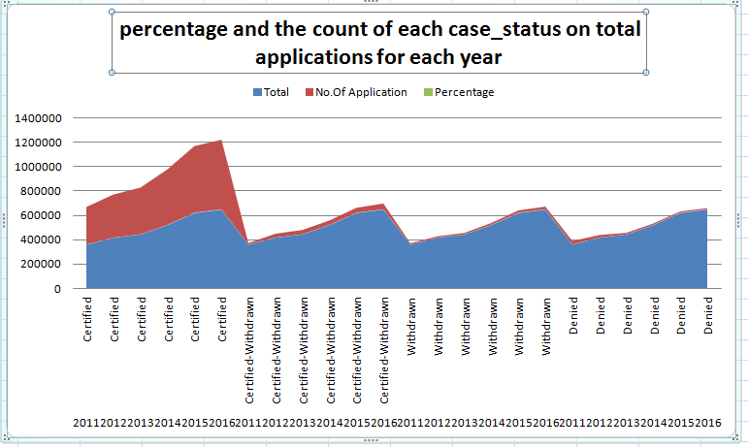
Analysing H1B Visa Using Hadoop Ecosystem
Analysis 6:
Find the percentage and the count of each case_status on total applications for each year, Creating a graph depicting the pattern of all cases.
Technology used: pig Latin
Sample output:
(2011,358767,307936,85.83175152675692)
(2012,415607,352668,84.85612609989725)
(2013,442114,382951,86.61815730784367)
(2014,519427,455144,87.62424748809747)
(2015,618727,547278,88.45225761927313)
(2016,647803,569646,87.93506667922192)

Slide 21
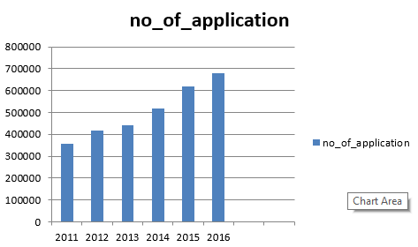
Analysing H1B Visa Using Hadoop Ecosystem
Analysis 7:
Create a bar graph to depict the number of applications for each year.
Technology used: hive and excel
Sample output:

Slide 22
Analysing H1B Visa Using Hadoop Ecosystem
Analysis 8:
Find the average Prevailing Wage for each Job for each Year (take part time and full time separate)
Technology used: pig Latin
Sample output:
(( SYSTEMS ANALYST,Y),42078.5)
(( COMPUTER SYSTEMS ENGINEER,Y),46218.0)
(( LEAD TEST ANALYST,Y),69389.0)
((ZOOLOGISTS AND WILDLIFE BIOLOGISTS I,Y),31803.0)
(( TEST ANALYST - US,Y),53872.0)
(( TECHNOLOGY ARCHITECT - US,Y),96033.0)
(( TEAM LEAD - US,Y),46779.0)
(( SOFTWARE TEST ENGINEER,Y),65936.0)
(( SR. BUSINESS INTELLIGENCE DEVELOPER,N),69909.0)
(( SOFTWARE PROGRAMMER,N),65042.0)

Slide 23
Analysing H1B Visa Using Hadoop Ecosystem
Analysis 9:
Which are top ten employers who have the highest success rate morethan 70% in petitions filed more than 1000?
Technology used: pig Latin
Sample output:
(INFOSYS LIMITED,130592,99.5405537858368)
(ACCENTURE LLP,33447,99.393069632553)
(TATA CONSULTANCY SERVICES LIMITED,64726,99.33720606865866)
(HCL AMERICA, INC.,22678,99.26801305229738)
(DELOITTE CONSULTING LLP,36742,98.32888792118013)
(WIPRO LIMITED,48117,98.28958580127606)

Slide 24
Analysing H1B Visa Using Hadoop Ecosystem
Analysis 10:
Which are the top 10 job positions which have the highest success rate morethan 70% in petitions filed more than 1000?
Technology used: Pig Latin
Sample output:
((SYSTEMS ENGINEER - US,10036,99.90035870864887)
(TECHNOLOGY LEAD - US,28350,99.80246913580247)
(TECHNOLOGY ANALYST - US,26055,99.7620418345807)
(LEAD ENGINEER,11157,98.23429237250157)
(DEVELOPER,12909,98.00914090944302)

Slide 25
Analysing H1B Visa Using Hadoop Ecosystem
Analysis 11:
Export result for question no 10 to MySql database.
Technology used: sqoop
Sample code:
sqoop export --connect jdbc:mysql://localhost/h1b_app --username root --password cloudera --table answer10 -- export-dir /success_rate2.txt -m 1;

Slide 26
Analysing H1B Visa Using Hadoop Ecosystem
THANK YOU…

